Slide 1







Enterprise Blockchain Developers (Intermediate)
In support of
Powered By

Slide 2
Outline
DataBase Design
© 2017-2020 SmartMesh Foundation Pte. Ltd. | MeshBox Foundation Pte. Ltd.

Slide 3
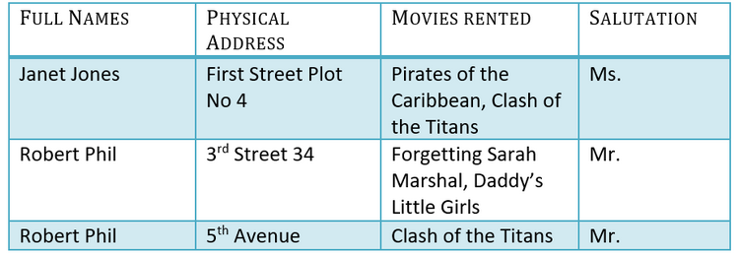
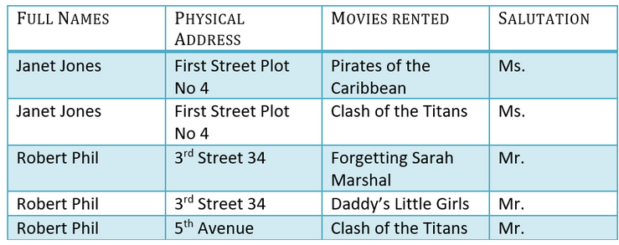
DataBase Design
1NF 2NF 3NF:
1NF: Each table cell should contain a single value.

Slide 4
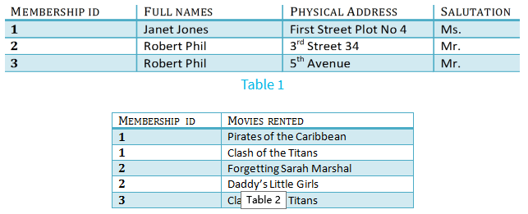
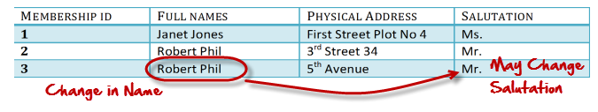
DataBase Design
2NF: Single Column Primary Key
3NF: Has no transitive functional dependencies
A transitive functional dependency is when changing a non-key column, might cause any of the other non-key columns to change

Slide 5
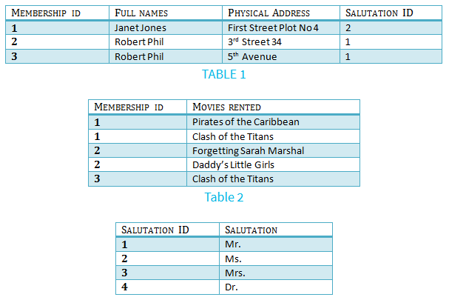
DataBase Design
3NF

Slide 6
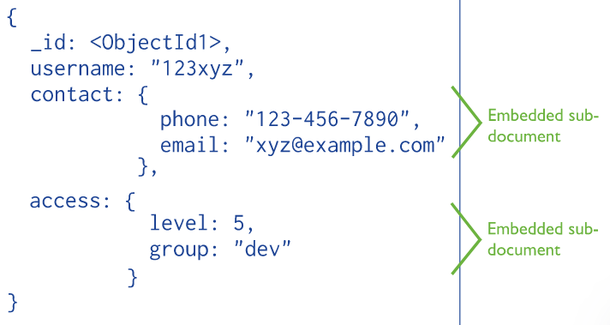
DataBase Design
Embedded Data Models: you may embed related data in a single structure or document

Slide 7
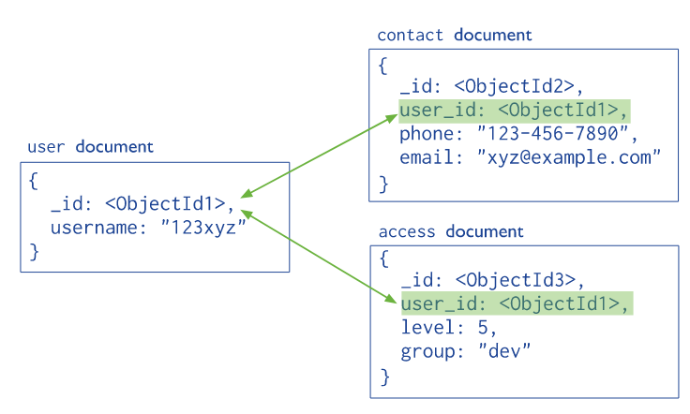
DataBase Design
Normalized Data Models: Normalized data models describe relationships using references between documents

Slide 8
DataBase Design
How to design an embeded data model
One to One Relationship
One to Many Relationship
Many to Many Replationship

Slide 9
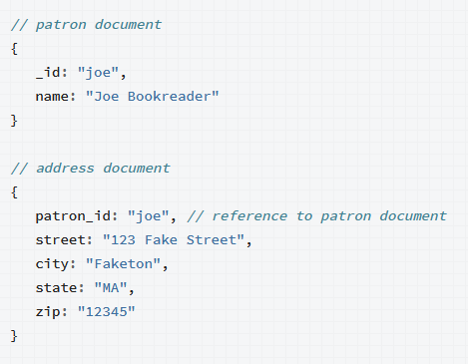
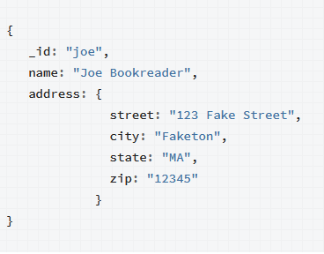
DataBase Design
One to One Relationship

Slide 10
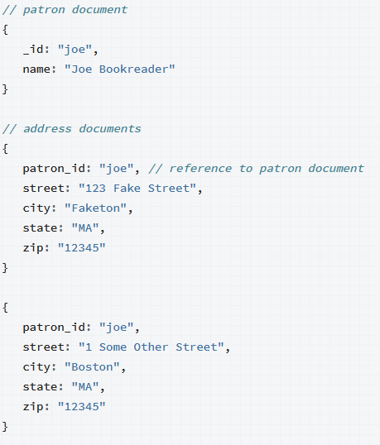
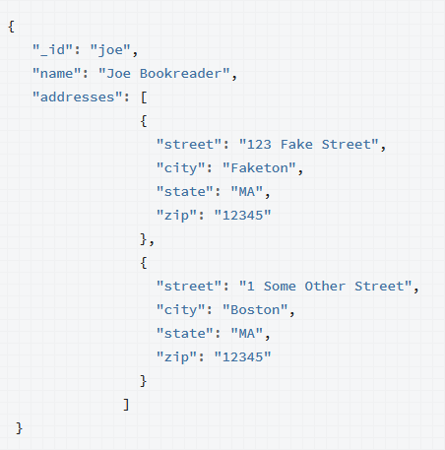
DataBase Design
One to Many Relationship and subset pattern

Slide 11
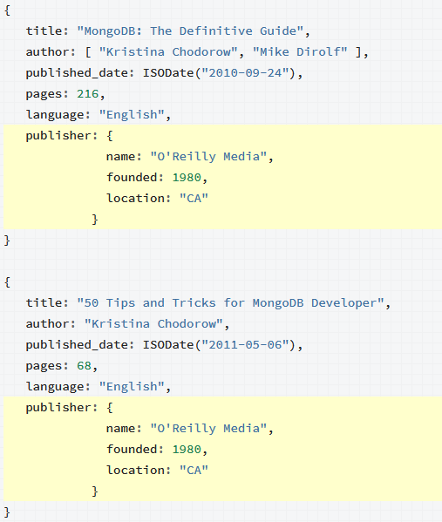
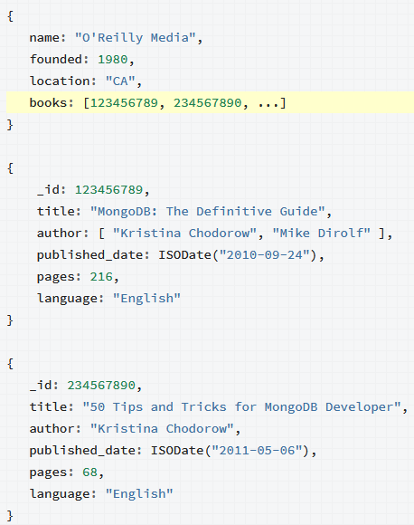
DataBase Design
One to Many Relationship with reference

Slide 12
DataBase Design
Solidity Data Design
Mappings, Arrays, and Struct
Mappings: Key - Value
mapping (address => uint) userBalances;
Arrays:
address[] userIndex;
userIndex.push(anAddress);
Strut:
struct UserStruct {
bytes32 userEmail;
uint userAge;}

Slide 13
DataBase Design
1) A struct, for record details. It will contain all the fields except the key.
2) A mapping of keys to struct instances.
3) An array that will be an unordered index of keys. In the example, these are user addresses.

